Slide 1
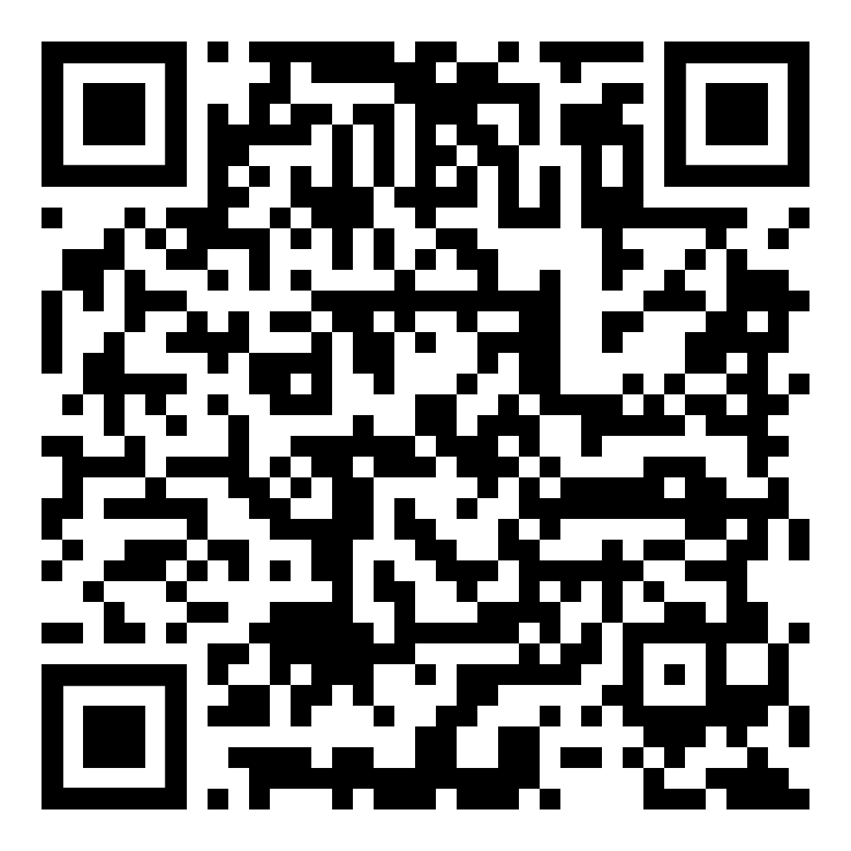
A Noob’s Journey into AI
Group 12
QRCode to SKLearn Pipeline!

Slide 2
Contents
01.
02.
03.
04.
04.
06.
Problem Exploration
Data
Processing
Feature Engineering
Proposed Solution
Results
Reflections

Slide 3
Problem Exploration

Slide 4
Problem Statement
The challenge presented is to develop a robust predictive model capable of forecasting future sales figures for these companies. The objective is to mine the dataset to identify trends, patterns, and potential causative factors that significantly impact sales outcomes. By integrating historical sales data with predictive analytics, the goal is to achieve accurate sales forecasts that companies can utilize to make informed strategic decisions, optimize inventory management, and allocate resources effectively.

Slide 5
Problem Statement
The challenge presented is to develop a robust predictive model capable of forecasting future sales figures for these companies. The objective is to mine the dataset to identify trends, patterns, and potential causative factors that significantly impact sales outcomes. By integrating historical sales data with predictive analytics, the goal is to achieve accurate sales forecasts that companies can utilize to make informed strategic decisions, optimize inventory management, and allocate resources effectively.

Slide 6



Available Data
Geospatial
Textual
Tabular
Latitude, Longitude
Company Description, Parent Country, etc
Sales (Global Ultimate Total USD), SIC Code, etc

Slide 7
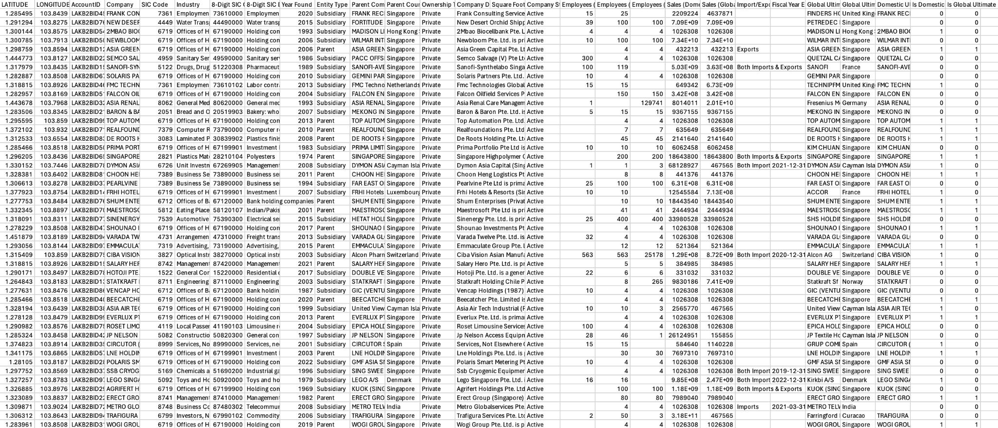
So… We can just use the data as is?

Slide 8
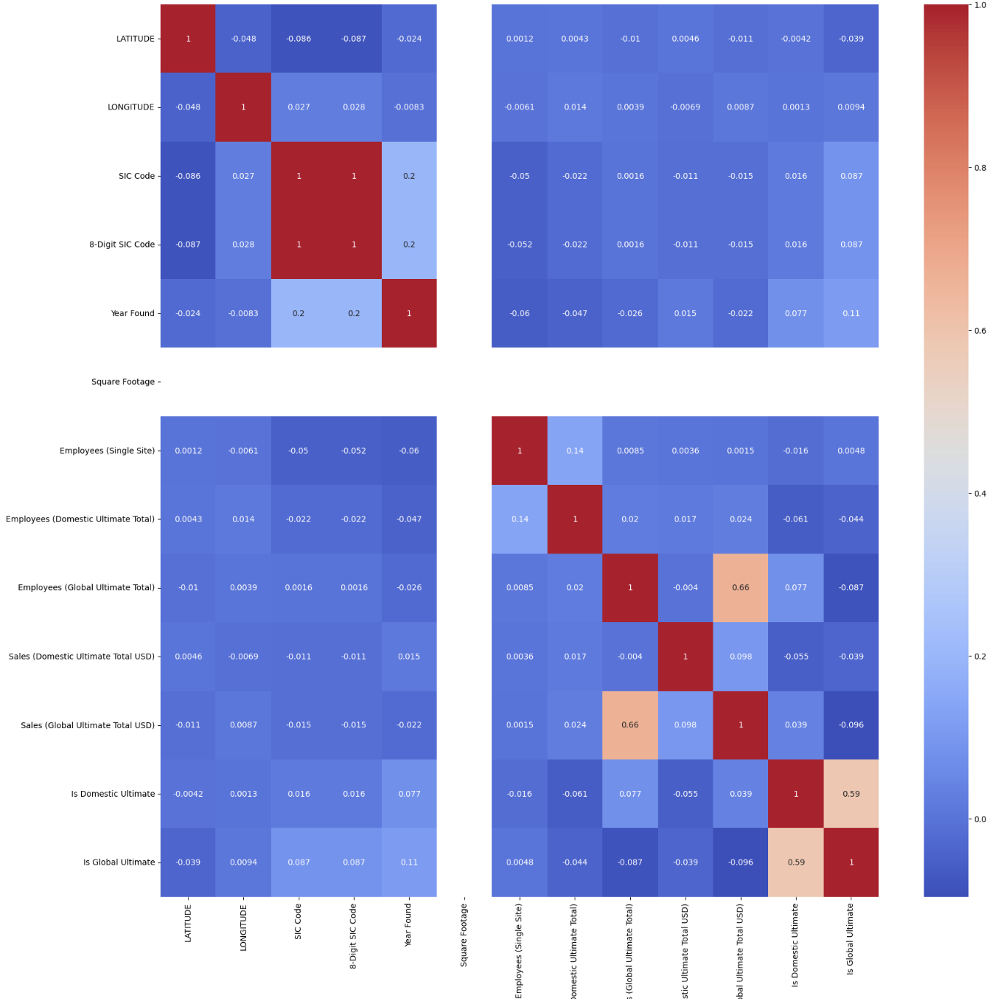
Correlation Matrix (Pearson)
😕
No Correlation?

Slide 9
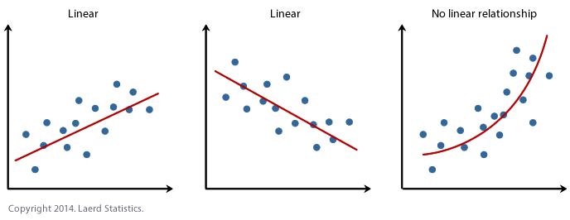
Spearman vs. Pearson
Pearson:
Linear Relation
Spearman: Non-linear Relation

Slide 10
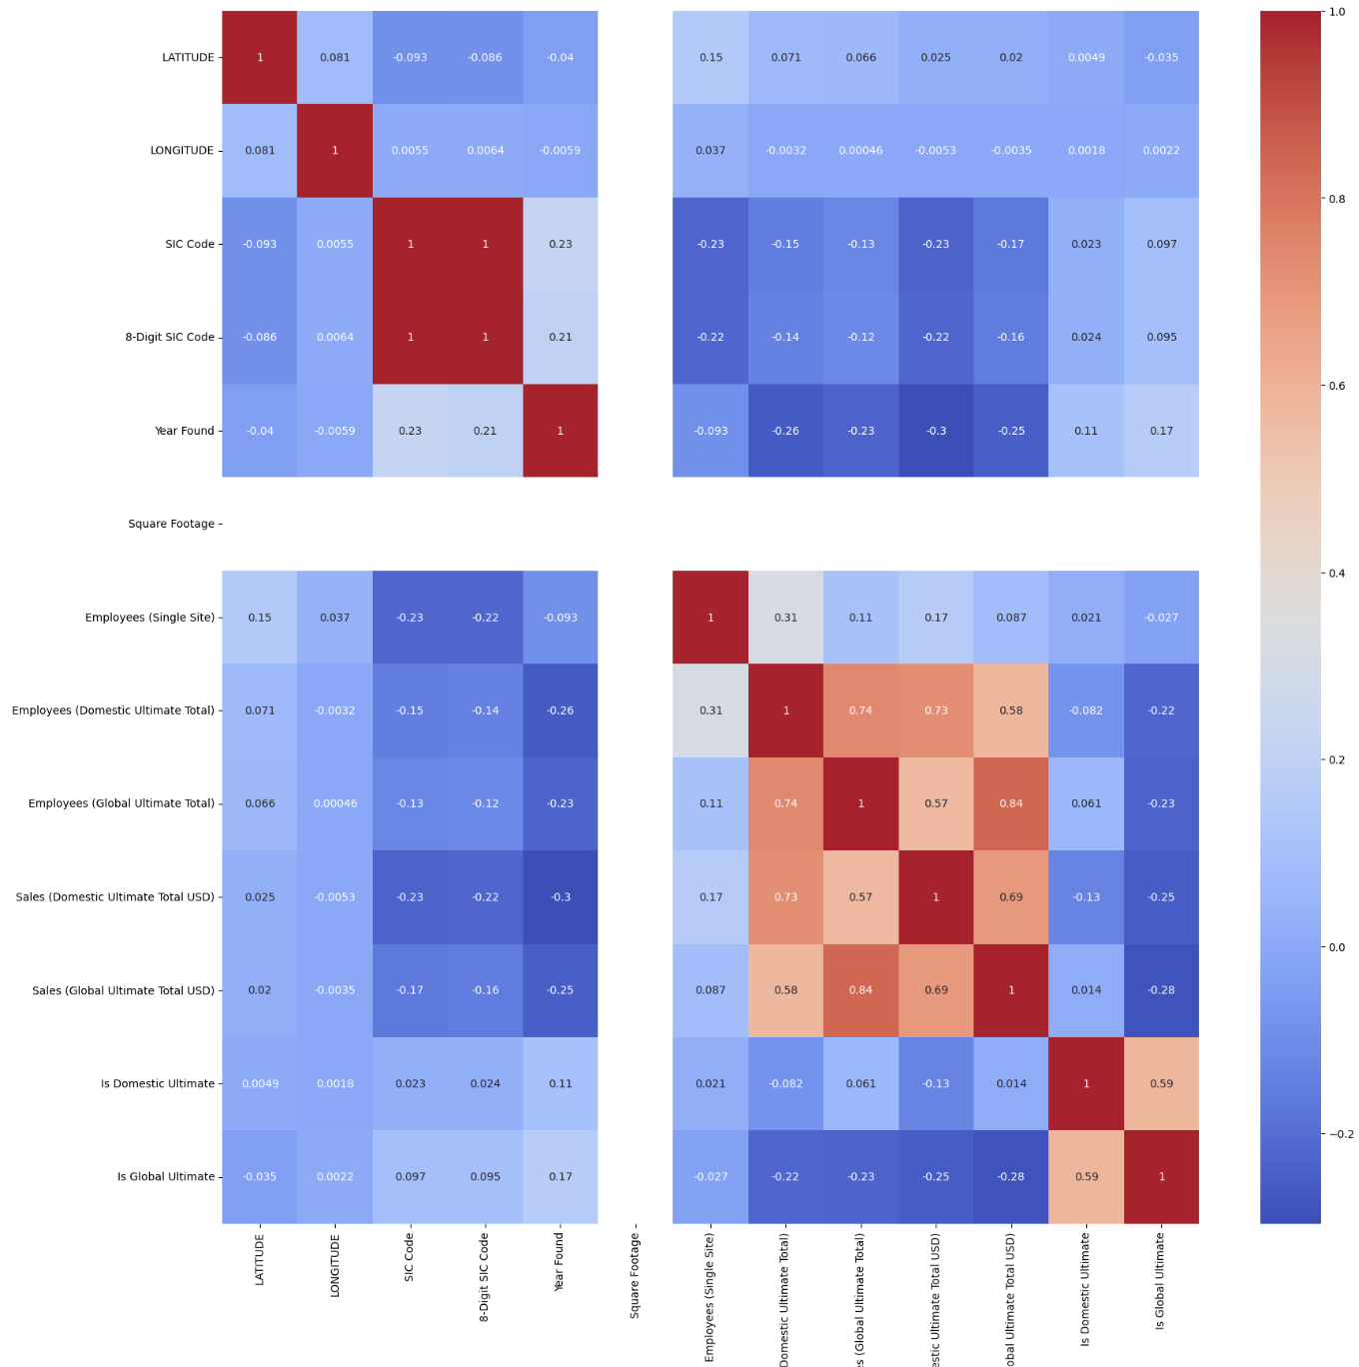
Correlation Matrix (Spearman)
🤨
Slightly Better?

Slide 11
Will Data Preprocessing Help?

Slide 12
Data Preprocessing
Dropping Columns
Removing unnecessary and/or (statistically) insignificant columns
AccountID
Square Footage
Company Status (Active/Inactive)
Ownership Type
Notes:
AccountID: Unique value with no meaning
Square Footage: Empty Column
Company Status: All are active → no meaning
Ownership Type: Statistically Insignificant (low correlation of <0.18 for spearman)

Slide 13
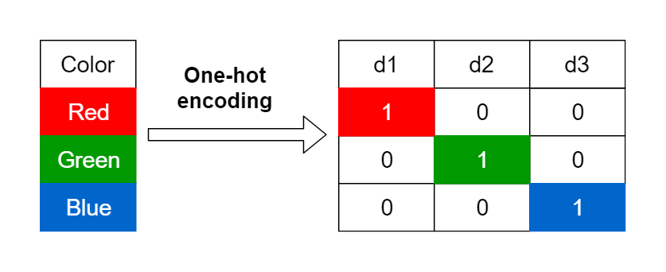
Data Preprocessing
One Hot Encoding (OHE)
Import/Export Status
Entity Type

Slide 14
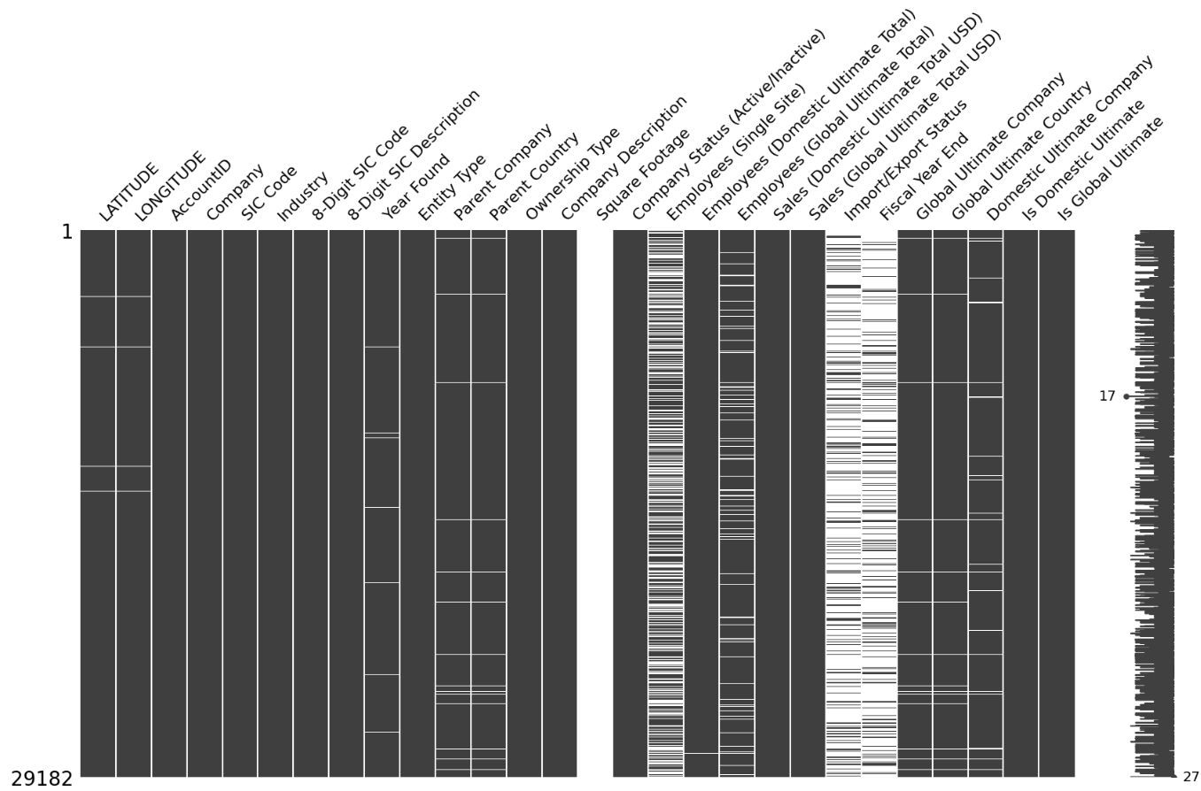
Null Values: Why Care?
Problem
Model cannot be trained if no data is present
Solution
Predict and impute missing values of data using AI

Slide 15
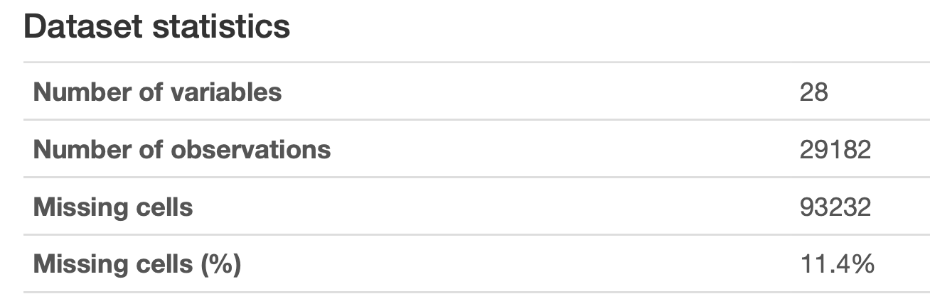
Why not just drop null values?
Less data vs More Data
Null values make up a large percentage of data

Slide 16
Null Values: Solution
How?
Predict value with k-Nearest Neighbours (kNN)
Predict value with Random Forest (RF)
Impute with the average of both models
Feed data into kNN -> Out1
Average =
(Out1 + Out2) / 2
Assign
null = Average
Start
Feed data into RF
-> Out2

Slide 17
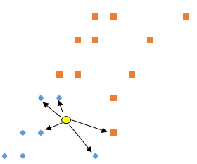
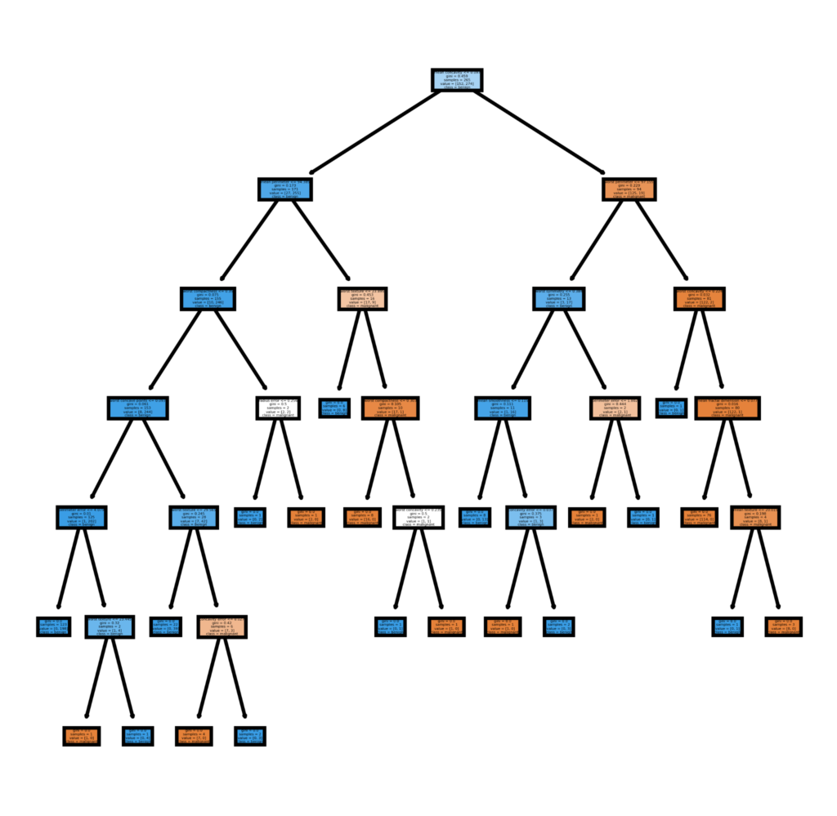
Why kNN and RF?
kNN
RF
Finds “closest” company
Decision Tree

Slide 18
Can we use the data to make predictions?
🤞

Slide 19
R² Score: 0.406
(Our model at this point was nearly identical to the workshop’s model)

Slide 20
Feature Engineering

Slide 21
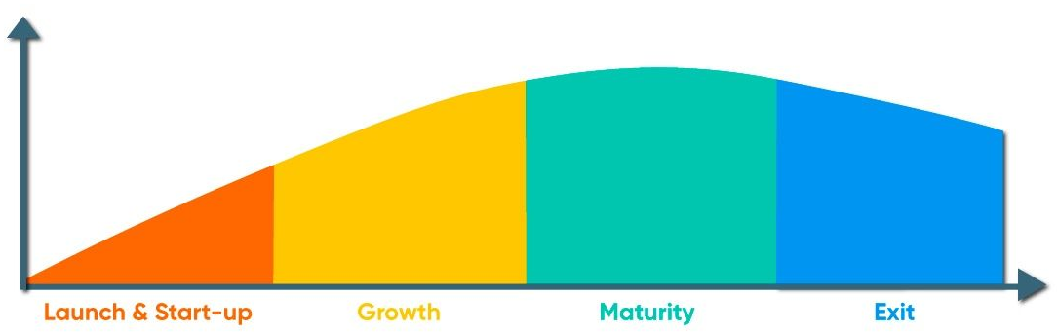
Feature Engineering: Business Life Cycle
4 Stages where Sales vary at different stages
Year Founded → Company’s Age
Differentiated based on SIC Code

Slide 22
Feature Engineering: Business Life Cycle
Disadvantages:
Does not account for extension strategies
Growth period varies based on marketing strategies
Low Correlation

Slide 23
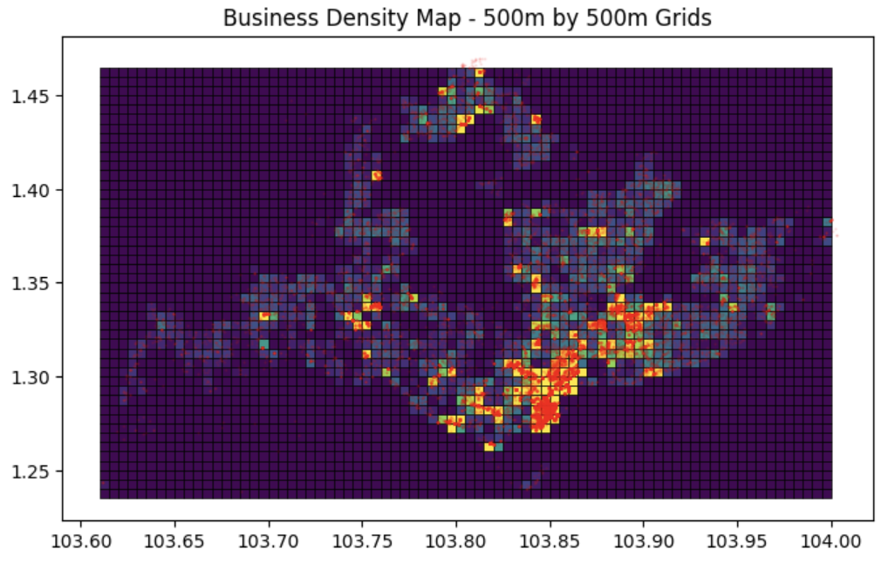
Feature Engineering: Geospatial Analysis
Business Density Maps:
Find business densities within grids
Identify business centres
Separation by SIC Code
Low Correlation

Slide 24
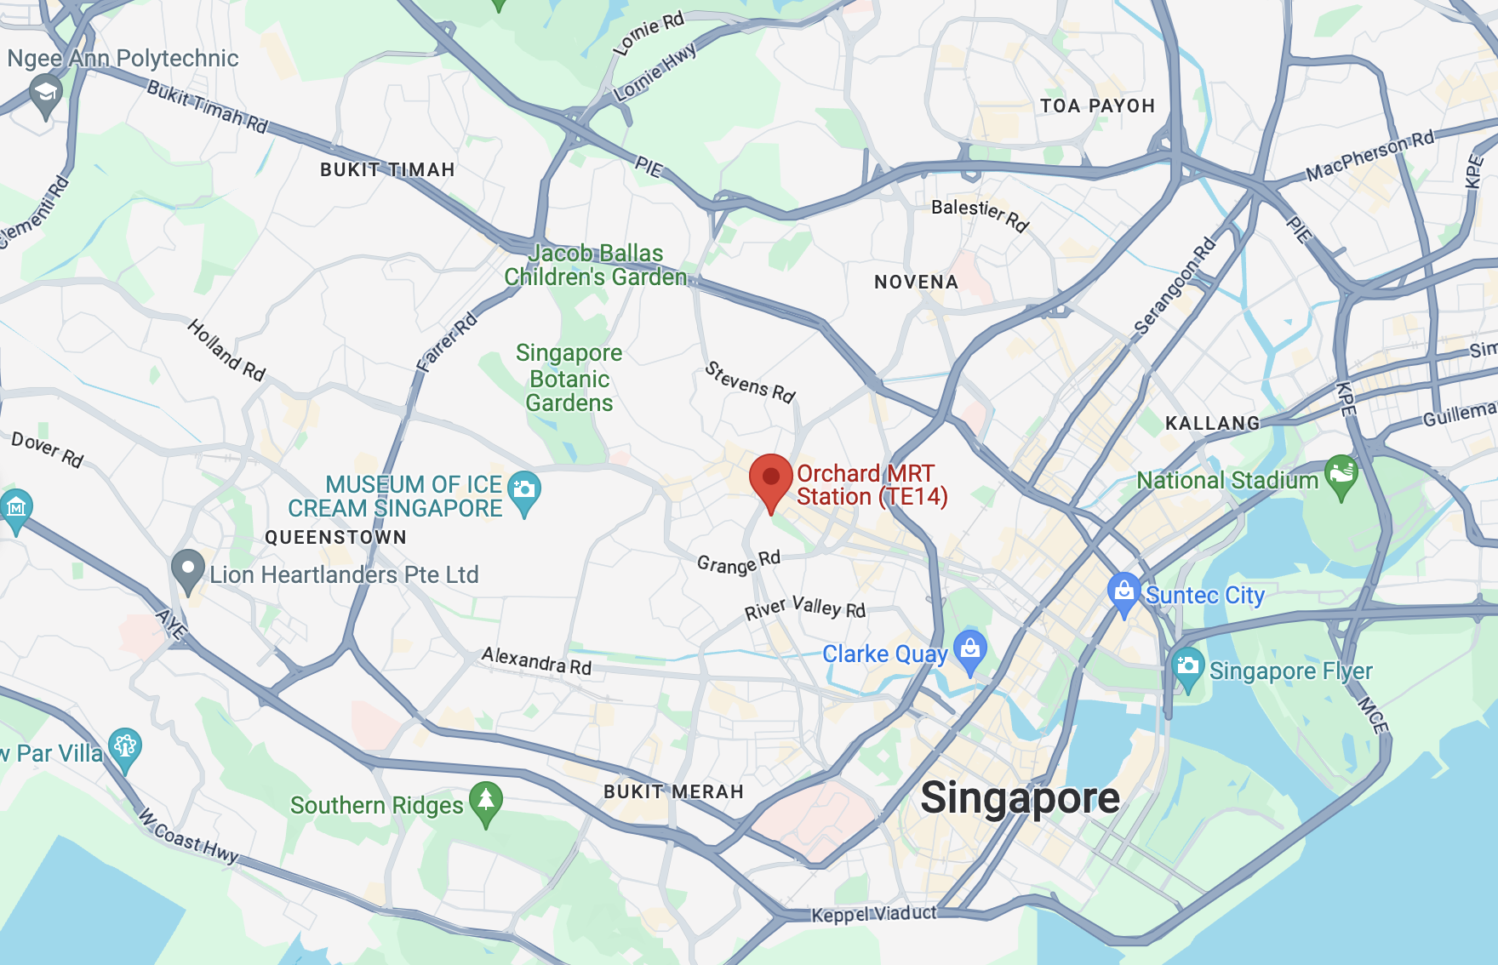
Feature Engineering: Location Analysis
Converting Latitude and Longitude into Locational Data
Example:
Input: (1.304024, 103.831541)
Output: (Orchard)
Disadvantage
Too computationally expensive, time constraint

Slide 25
How now?

Slide 26
Types of Data Available
What have we explored?
Geospatial
Tabular
Textual

Slide 27
“Fixing Text”
Tokenization
Breaking down sentences into simpler words/subwords
Allows tokens to be quantified and used for data analysis
Example…
“We have no idea!” → “we”, “have” , “no”, “idea”, “!”

Slide 28

“Fixing Text”
Removing Punctuation
Remove unnecessary elements
Stopword Removal
Removing words such as: “the”, “is” & “and”
Stemming
Reducing words to their simplest form: “Consulting” → “Consult”

Slide 29
“Fixing Text”
Consider the following sentence…
The quick brown fox jumps over the lazy dog, and they both enjoy a relaxing afternoon in the sun
Fixed sentence!
The quick brown fox jumps over the lazy dog, and they both enjoy a relaxing afternoon in the sun

Slide 30
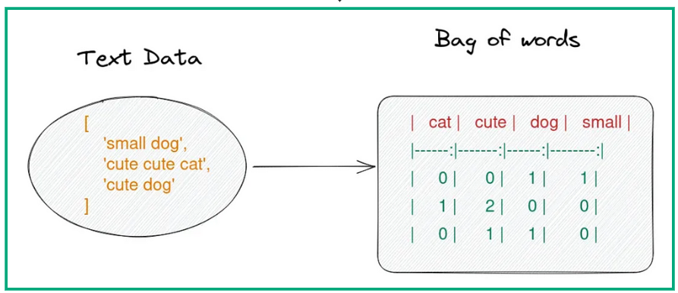
Bag of Words + Freq Table

Slide 31
Term Frequency-Inverse Document Frequency
TF-IDF Works in 3 Stages
Term frequency
TF(t,d) = freq(t) / count(d)
Inverse document frequency
IDF(t, D) = log(count(D) / count(t)+1)
TF-IDF Score
TF-IDF(t, d, D) = TF(t, d) * IDF(t, D)

Slide 32
Proposed Solution

Slide 33
Final Feature Selection
“The more the merrier”
A combination of
TF-IDF (NLP) and Tabular Data

Slide 34
Model Selection
We trained multiple Machine Learning models to find the one that returns the highest R² value

Slide 35
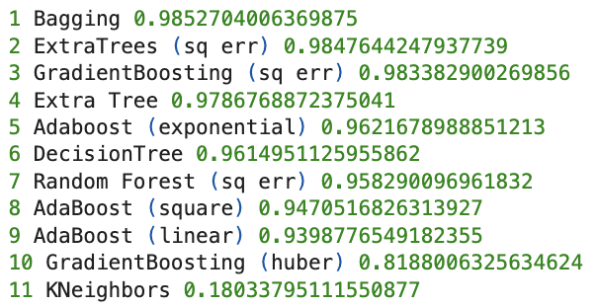
Model Selection: Results

Slide 36
Bagging Regressor?
→ Sampling (Features, Data) with replacement
→ Aggregation
Combining several “weak” Decision Tree regressors
→ Prevents Overfitting, Enhanced accuracy

Slide 37
Curse of Dimensionality?
21053 columns → Surely there is an issue here…
Yet,
Decision Trees as a base estimator
Bagging: Random subset of features

Slide 38
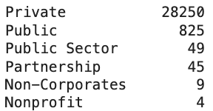
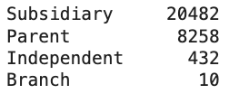
Imbalanced Data
Model will be biased towards more represented groups
Entity Type
Ownership Type
Note: Ownership Type was dropped due to low correlation

Slide 39
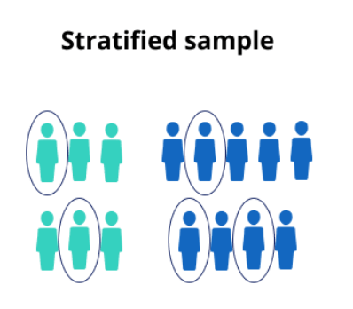
Improved Model Training
Stratified Sampling instead of k-Fold Validation
Ensures that underrepresented data evenly split, remedies imbalanced data issue

Slide 40
Final Results?

Slide 41
R²
0.9826345534247569
Adjusted R²
0.9376548847795069

Slide 42
Reflections
Summary and Implications
NLP Features vs Tabular Features vs GeoSpatial Features
Why does NLP work compared to others?
What does this mean

Slide 43
Thank You!

